Slide 1
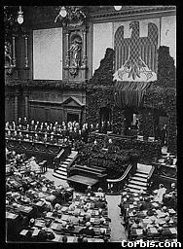
The Weimar Republic 1924-1929
– a summary
The Golden Age?

Slide 2
Weimar before 1924
The Weimar Republic was born out of the German defeat in World War One. Many Germans associated the Weimar Republic with the defeat and with the hated Treaty of Versailles.
Germany struggled to accept democracy and both left-wing and right-wing extremists attempted to undermine Weimar democracy.
1923 – was a year of crisis for Weimar. The Munich Putsch, French occupation of the Ruhr and Hyperinflation, all caused problems for the Republic.

Slide 3
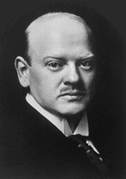
Gustav Stresemann
In 1925 agreed to the Locarno Treaties with Belgium and France which set the borders of Germany. In 1926 helped negotiate Germanys entry into the League of Nations. (These two events helped to improve relations between France, Britain and Germany)
In 1929 the Young Plan was introduced. This greatly reduced the amount of reparations for Germany and she was given longer to pay it back.
Chancellor of Germany in 1923.
Managed to bring an end to the Ruhr occupation crisis and the Hyperinflation situation (by introducing a new currency the Rentenmark).
Accepted the Dawes Plan in 1924, whereby Germany borrowed money off America to help repay their reparations.

Slide 4

Real Recovery?
The Dawes Plan (1924) is generally accepted as marking the beginning of recovery in Germany in the 1920s.
However, although Germany did appear to begin getting back on it’s feet, it was heavily reliant on foreign loans. Between 1924 and 1930 25.5 billion marks (in loans) flowed into Germany.

Slide 5
Real Recovery?
By 1929 industrial production had surpassed its pre-1914 level.
Growing number of large businesses – growing class of industrialists.
Unemployment relatively high by 1929 – not everyone benefited from the ‘Golden Age’.
Agricultural sector not prospering.

Slide 6
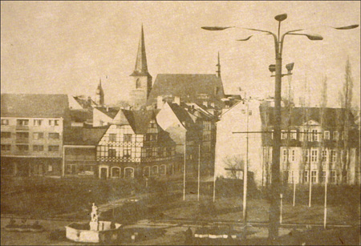

Weimar by 1929
The ‘Golden Age’ had seen an explosion of art and literature and many people had enjoyed new freedoms.
The situation for many ordinary Germans seemed considerably better than it had just a few years before. However the Weimar Republic was still economically and politically vulnerable.

Slide 7
Did the economic, political and foreign policy decisions of the ‘Golden Age’ make the Weimar Republic more stable by 1929?

